Slide 2
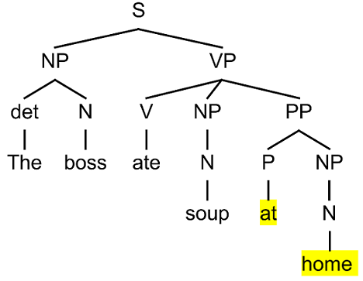
Parse tree (linguistics)

Slide 3
Expression tree or
parse tree

Slide 4
Abstract syntax tree

Slide 5
Game tree

Slide 6
Decision tree

